Slide 1
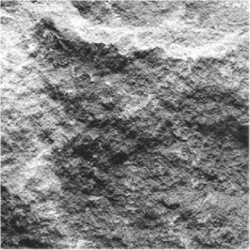
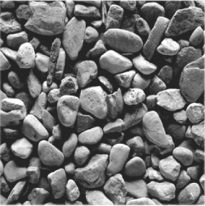
2016 Spring Thaw
Columbus Ohio
March 2, 2016

Slide 3
AGENDA
NSSGA’s Commitment to Safety & Health
NSSGA’s Dialogue with MSHA
Tips for Managing for Fatality Avoidance
Ideas for Teamwork in Safety & Health
Get It Right on Regulation

Slide 4
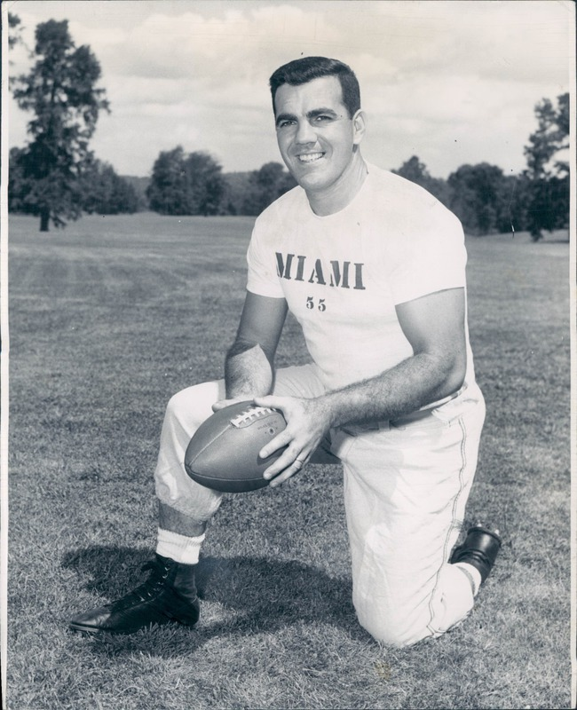
Luck is nothing more than preparation meeting opportunity. – Ara Parseghian

Slide 5
NSSGA’s COMMITMENT TO SAFETY & HEALTH
NSSGA’s S&H guidelines adopted almost a quarter century ago
Safety & Health committee consists of 200 professionals involved in safety and health
Committee delivers programs to enhance compliance as well as worker safety and health

Slide 6
NSSGA’s COMMITMENT TO SAFETY & HEALTH

Slide 8
NSSGA’s COMMITMENT TO SAFETY & HEALTH
NSSGA Occupational Health Program Guideline
Management commitment
Comprehensive employee comm’s & training
Exposure monitoring & control
Medical monitoring
Process for periodic evaluation & auditing
Emphasis on smoking cessation

Slide 9
NSSGA’s COMMITMENT TO SAFETY & HEALTH
Develop Training Materials:
Mineral Identification & Management Guide
Periodic on-site inspections
Program for testing settled dust
Qualitative geologic survey
Further steps

Slide 10
NSSGA’s COMMITMENT TO SAFETY & HEALTH
Collaborate with NIOSH
Participate in meetings re: future training needs
Reviewed study on Noise effects
Sponsor annual workshop on safety in underground aggregates facilities

Slide 11
NSSGA’s COMMITMENT TO SAFETY & HEALTH
Cooperate with MSHA thru initial Alliance:
Conduct educational workshops on noise & dust
Develop training materials like ‘Safety Alerts’ based on analysis of MSHA injury data
Notes:
Even before the MSHA-NSSGA Alliance, the association worked with MSHA on establishment of Part 46, as well as noise and dust workshops to cite a few examples.
Develop training materials (3 so far this year):
- Slips trips and falls / electrical / welding and cutting
Conduct Educational workshops (3 this year, 1 other post-poned):
- N&D we had @ 20 students in two, 3 day-long workshops
- workshop on DPM was postponed, due to litigation
- on ACRI, hosted two dozen for a 3 day event
Issue newsletter (3rd this year is about ready to go: on safety management systems):
analysis of injury data for Alerts / promo for
MSHA’s Spring Thaw Series / safety in an econ. downturn
NIOSH:
- NSSGA last month provided analysis for a NIOSH study on noise
exposure conducted
- staging a webinar on 11/19 on dust control systems
- preparing a day-long workshop at 2010 Convention on risk awareness

Slide 14
NSSGA’s COMMITMENT TO SAFETY & HEALTH

Slide 16
AGENDA
NSSGA’s Commitment to Safety & Health
NSSGA’s Dialogue with MSHA
Tips for Managing for Fatality Avoidance
Ideas for Teamwork in Safety & Health
Get It Right on Regulation

Slide 17
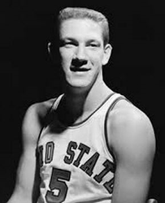
Over the years, I’ve had hundreds of shots blocked. But, you’ve got to go in and take chances. – John Havlicek

Slide 18
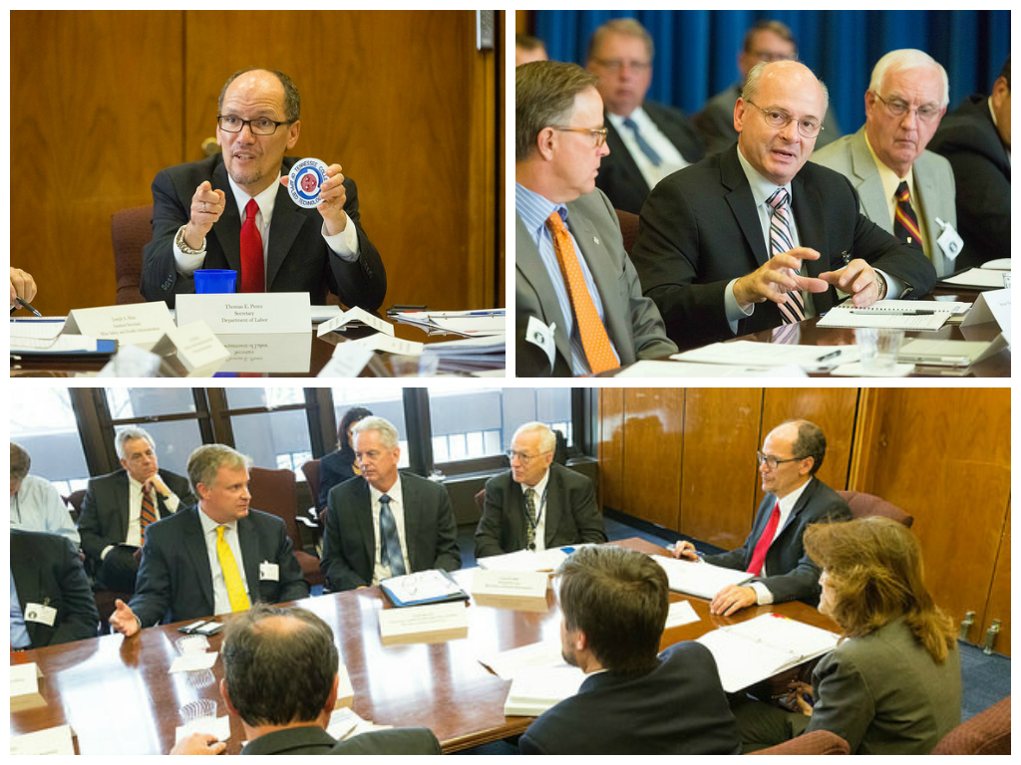

Slide 19
DIALOGUE
NSSGA advocated for continued improvement in enforcement consistency.
NSSGA urged that MSHA keep open the Small Mines Office/Consultation Program.

Slide 20
DIALOGUE
NSSGA advocated for clarification of what’s needed for compliance. Agency helpfully responded with:
- some sharing of inspector-training
materials, and
- heads-ups on future enforcement pushes
on Rules to Live By program, and Parts
.5002 (air contaminants) and .6200
(noise).

Slide 22
DIALOGUE
Agency formed a Technical Task Force of the Alliance. NSSGA succeeded in securing from MSHA clarifying language on what’s needed for compliance on such matters as:
Fall protection for miners on mobile equipment;
Fall protection for miners on work platforms fewer than six feet off the ground; and
Seatbelt replacement.

Slide 23
DIALOGUE
NSSGA advocated for fully funding the State Grants program for safety training.
NSSGA urged that MSHA develop a Pattern of Compliance program:
- afford excellent operators the chance to earn
enforcement credit, e.g., reduction in
mandatory 2s and 4s.

Slide 24
DIALOGUE
NSSGA argued against rulemakings on:
- safety and health management systems, and
- safety for dams and impoundments.

Slide 25
DIALOGUE
NSSGA submitted robust comments on OSHA crystalline silica rule proposal aiming to:
- Reduce permissible exposure limit to 50 μg/m3
- Establish action level of just 25 μg/m3
- Trigger complicated ancillary provisions
Proposal would cost $billions annually to comply

Slide 26
DIALOGUE
NSSGA & other plaintiffs went to US Court of Appeals for the Sixth Circuit to fight MSHA’s final rule on Pattern of Violations (POV). Court ruled it had no jurisdiction.
NSSGA now taking fight to District Court in Ohio. Oral arguments to be heard April 12.

Slide 27
AGENDA
NSSGA’s Commitment to Safety & Health
NSSGA’s Dialogue with MSHA
Tips for Managing for Fatality Avoidance
Ideas for Teamwork in Safety & Health
Get It Right on Regulation

Slide 28
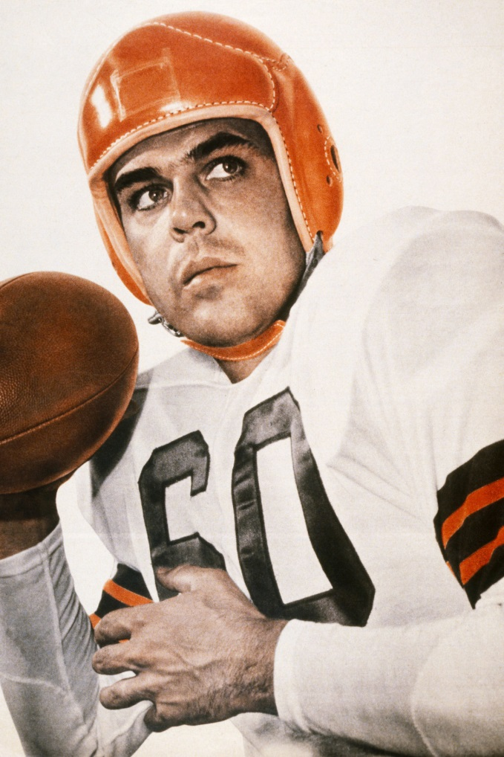
Do not throw in the towel. Use it to wipe the sweat off your face. - Otto Graham

Slide 29
Fatality Avoidance - Hazard Recognition
A. Workplace exams done thoroughly
Employers and employees should examine their workplaces to detect any unsafe or unhealthful conditions, practices, or equipment and take the necessary steps to correct them.

Slide 30
Fatality Avoidance - Hazard Recognition
B. Pre-shift exams done thoroughly
Self-propelled mobile equipment to be used during a shift shall be inspected by the equipment operator before being placed in operation on that shift.

Slide 31
Fatality Avoidance - Training
A. Aim for quality training of adults.
B. Utilize ‘best practices’ information provided
by MSHA, NSSGA and other qualified
entities. For instance: a trainer could take a
fatalgram, remove the text and use the
pictures to show trainees in asking how – at
our facility – could this kind of fatality occur?

Slide 32
Fatality Avoidance - Training
C. Make it interesting/interactive - If you want to
teach a miner, you have to make it compelling.
After all, this is:
part lecture
part demonstration
part entertainment.

Slide 33
Fatality Avoidance - Training
Presentation - How will the information be
presented? This should be developed and
practiced well in advance.
Application - People learn better when they get to put to use that which they’ve been instructed.

Slide 34
Fatality Avoidance - Training
Evaluation - There must be a method of
evaluation to ensure that the participants have
genuinely learned. This can be done in the
form of a competitive game, e.g., ‘Jeopardy.’

Slide 35
Fatality Avoidance - Risk Tolerance
Overestimating Capability or Experience: A belief that one’s physical ability or experience allows them to perform the task without injury.
Familiarity with the Task – Complacency: Over-confidence especially when accompanied by unawareness of actual dangers or deficiencies.

Slide 36
Fatality Avoidance - Risk Tolerance
C. Seriousness of the Outcome – What could
happen?: When we assume that an action’s
outcome will not be serious, we are prepared
to accept more risk (e.g., “How bad could it
be?”)
D. Familiarity with the Task – Complacency:
“When I’m in charge…the risk is (somehow) lower.”

Slide 37
Fatality Avoidance - Risk Tolerance
E. Confidence in Protection and Rescue:
Blind faith that our safety equipment will protect
us, or that rescue will be immediate if we do get
in trouble, the acceptance of risk increases.

Slide 38
Fatality Avoidance - Risk Tolerance
F. Potential Profit/Gain from Actions: A
person or corporation may accept a higher
level of risk if there is substantial profit or gain
for the risk action (e.g., short-cut in order to
make a production quota).
G. Role Models Accepting Risk: The level of risk
accepted by role models/mentors will
impact our own levels of risk acceptance.

Slide 39
AGENDA
NSSGA’s Commitment to Safety & Health
NSSGA’s Dialogue with MSHA
Tips for Managing for Fatality Avoidance
Ideas for Teamwork in Safety & Health
Get it Right on Regulation

Slide 40
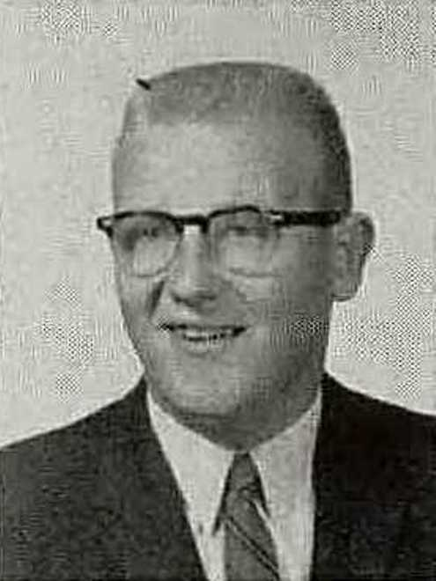
Life is 10 percent what happens to you, and 90 percent what you do about it. – Lou Holtz

Slide 41
LEADERSHIP IN ACTION – Six Innovative Ideas
- Wing Man
- Leadership Weekends
- Safety Blitz
- District Steering Safety Team
- Saved My Bacon

Slide 42
WINGMAN - DESCRIPTION
The concept of a Wingman, originated in the movie “Top Gun,” is utilized to drive home the point that we must all look out for each other.
It’s reinforced by calling attention to actions and consequences with and without a wingman who is looking out for your safety.

Slide 43
WINGMAN - RESULTS
It has become part of the culture in the operation, with people constantly asking, “who is your wingman?” or stopping un-safe acts by telling a co-worker that, “I am your wingman.”
The operation has wings, and wingman signs, shirts and hats, with “who is your wingman?” printed.

Slide 44
LEADERSHIP WEEKENDS - DESCRIPTION
Recognizing that it’s the front line leaders (leadmen and supervisors) who keep the operations running on:
weekends,
training days, and
off-shifts,
The operator began a safety leadership program aimed solely at these workers.

Slide 45
LEADERSHIP WEEKENDS - RESULTS
Saturday sessions were held to deliver information, and build workers’ ability to trust their peers, and effectively deliver safety messages.
The company CEO called into one of the meetings, this made a significant impact.

Slide 46
SAFETY BLITZ - DESCRIPTION
Started by a maintenance supervisor, this monthly program gets eight random employees from throughout the district, to descend, and conduct an MSHA inspection-type evaluation.
Resultant feedback is done via private discussions with some employees related to behaviors, management effectiveness, etc.

Slide 47
SAFETY BLITZ - RESULTS
The results go only to the employees of the blitzed operation, and the employees correct deficiencies that were noted and/or photographed.
This program is the primary reason why the operator had zero violation inspections at three operations (18 days), and why the VPID rate is below the national average.

Slide 48
DISTRICT STEERING SAFETY TEAM - DESCRIPTION
To maximizes effectiveness of a district’s safety program, the operation established a district-wide safety team to review the safety process at all operations.

Slide 49
DISTRICT STEERING SAFETY TEAM - RESULTS
This District team is composed of, led, and facilitated by hourly employees.
This ‘bottom-up’ process elicits much participation & problem-solving feedback.

Slide 50
SAVED MY BACON - DESCRIPTION
Operator wants all employees to know the rules and regulations. However, tracking this is challenging.
So a front-line leader at one of our operations designed and started a “Saved My Bacon” recognition.
Over the course of a month, an employee can drop into a secured hard hat the name of anyone who may have helped him work more safely.

Slide 51
SAVED MY BACON - RESULTS
Periodically, the names are drawn from the hard hat, and all names are read. The name read most often gets to pick out a gift from a catalog.
This is very popular as it eliminated paperwork…but really encourages safe behavior.

Slide 52
AGENDA
NSSGA’s Commitment to Safety & Health
NSSGA’s Dialogue with MSHA
Tips for Managing for Fatality Avoidance
Ideas for Teamwork in Safety & Health
Get it Right on Regulation

Slide 53
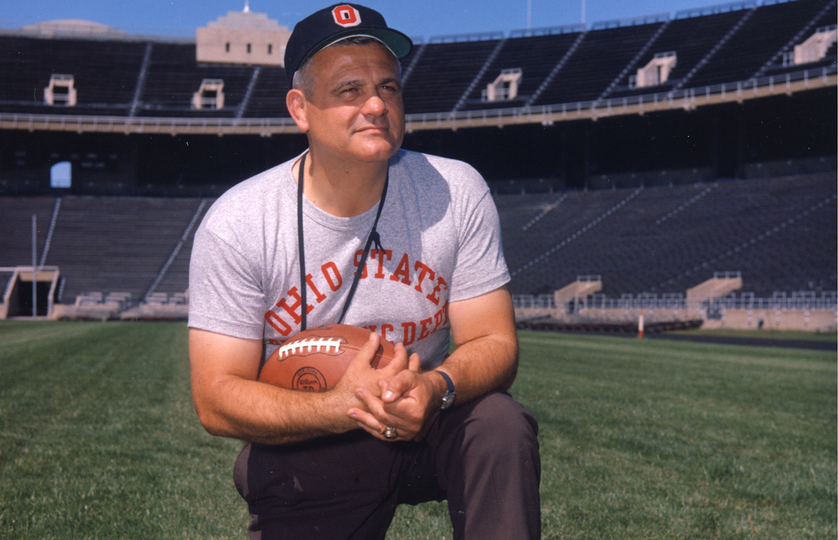
No back in the history of football was worth two fumbles a game. – Woody Hayes

Slide 54
GET IT RIGHT ON CIVIL PENALTIES
MSHA claims goals of rule proposal
are to:
- improve objectivity & consistency in
citation writing;
- earlier resolution of issues due to fewer disputes;
- greater emphasis on more serious violations;
- provide increased openness & transparency.

Slide 55
GET IT RIGHT ON CIVIL PENALTIES
NSSGA is concerned with multiple provisions:
- Inducement to operators to not contest
citations
Effort to curb Review Commission discretion in penalty amounts
Reduced range of choices in evaluating Negligence

Slide 56
GET IT RIGHT ON CIVIL PENALTIES
NSSGA is concerned with multiple provisions of the Civil Penalties rule, including (cont’d):
Reduced range of choices in evaluating Gravity
Substantial increases in penalty assessment costs

Slide 57
GET IT RIGHT ON
WORKPLACE EXAMS
NSSGA is concerned that a new rule on workplace exams will risk:
treating inspectors as safety specialists;
bureaucratizing the process of managing for safety;
creating more red tape; and
increasing costs for operators.

Slide 58
AGENDA
NSSGA’s Commitment to Safety & Health
NSSGA’s Dialogue with MSHA
Tips for Managing for Fatality Avoidance
Ideas for Teamwork in Safety & Health
Get It Right on Regulation

Slide 59
Spring Thaw 2016
Columbus, Ohio
March 2, 2016

